Slide 1
Introduction to Avalon Interface
Hardik Shah
Robotics and Embedded Systems
Department of Informatics
Technische Universität München
www6.in.tum.de
06 May 2013

Slide 2
What is On-chip Bus?
M1
M2
M3
Arbiter
S1
S2
S3

Slide 3
What is On-chip Bus?
M1
M2
M3
S1
S2
S3
Arbiter
Bottleneck
S1
S2
S3

Slide 4
Slave-side Arbitration
M1
M2
M3
Arbiter
Arbiter
Arbiter
S1
S2
S3

Slide 5
Avalon Signals
ONLY a master initiates a transaction
Master
Avm_Address (Byte)
Avm_Byte_Enable
Avm_Write
Avm_Read
Avm_Write_Data
Avm_Read_Data
Avm_Wait
Avm_Read_Data_Valid
Slave
Avs_Address (Word)
Avs_Chip_Select
Avs_Byte_Enable
Avs_Write
Avs_Read
Avs_Write_Data
Avs_Read_Data
Avs_Wait
Avs_Read_Data_Valid
Clock, Reset

Slide 6
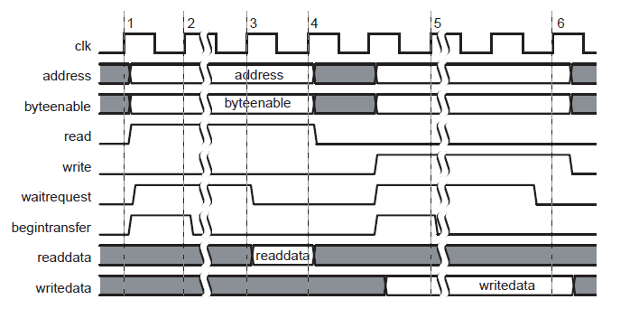
Basic transfers

Slide 7
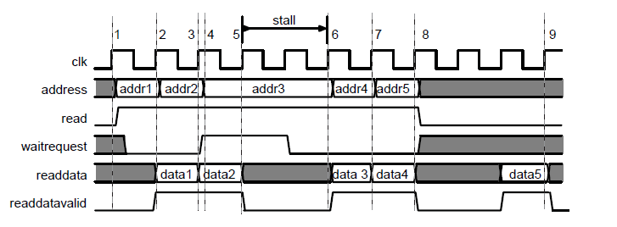
Pipelined Transfers

Slide 8
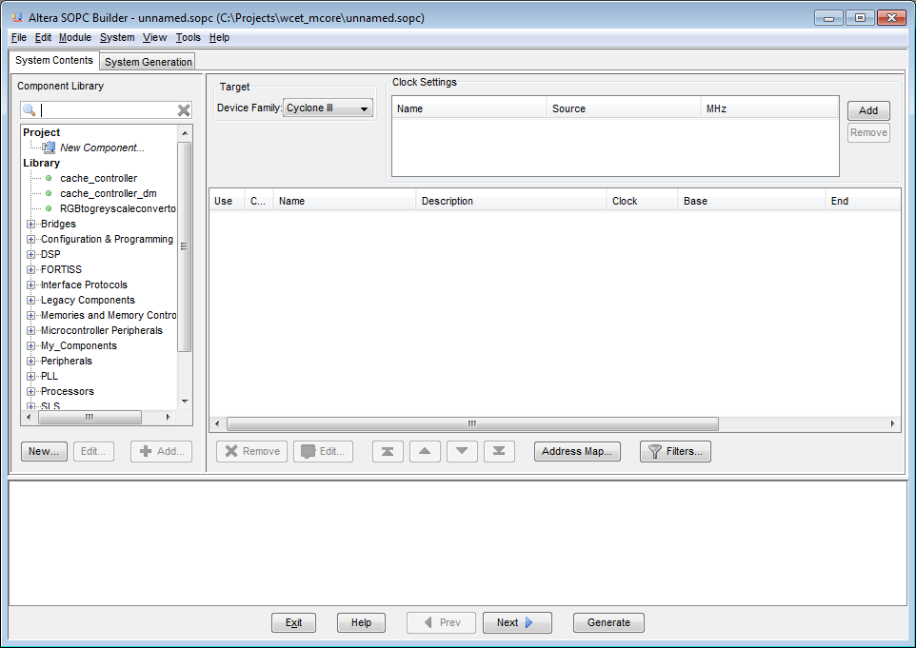
How to Integrate with SOPC/QSyS

Slide 9
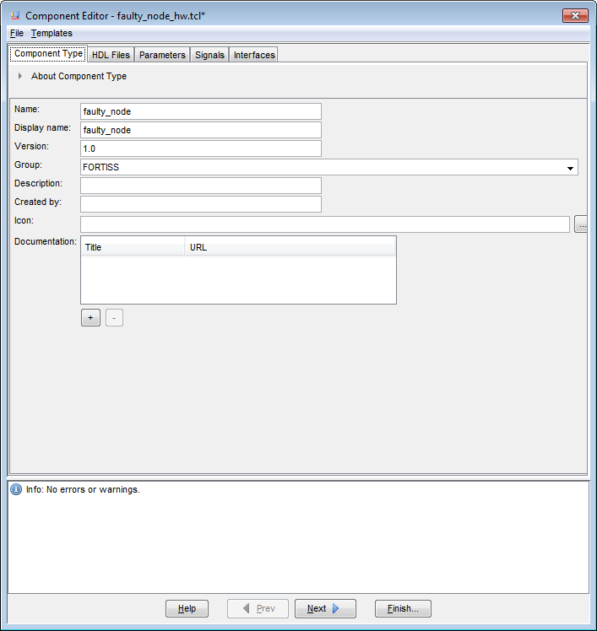
How to Integrate with SOPC/QSyS

Slide 10
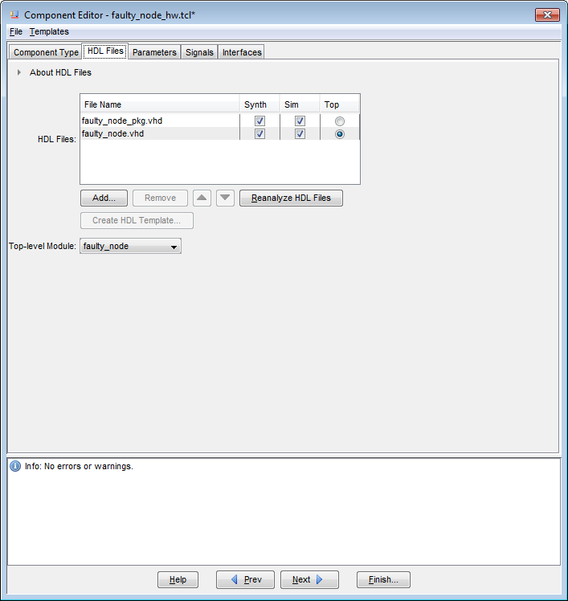
How to Integrate with SOPC/QSyS

Slide 11
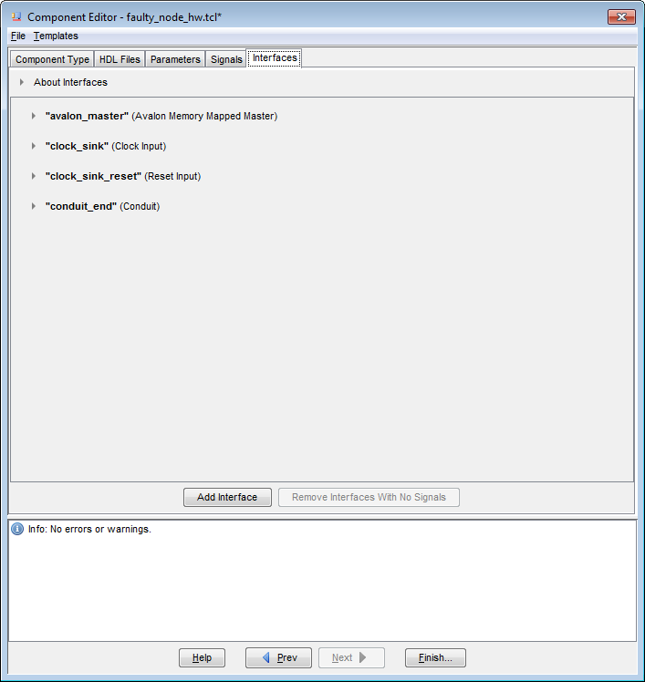
How to Integrate with SOPC/QSyS

Slide 12
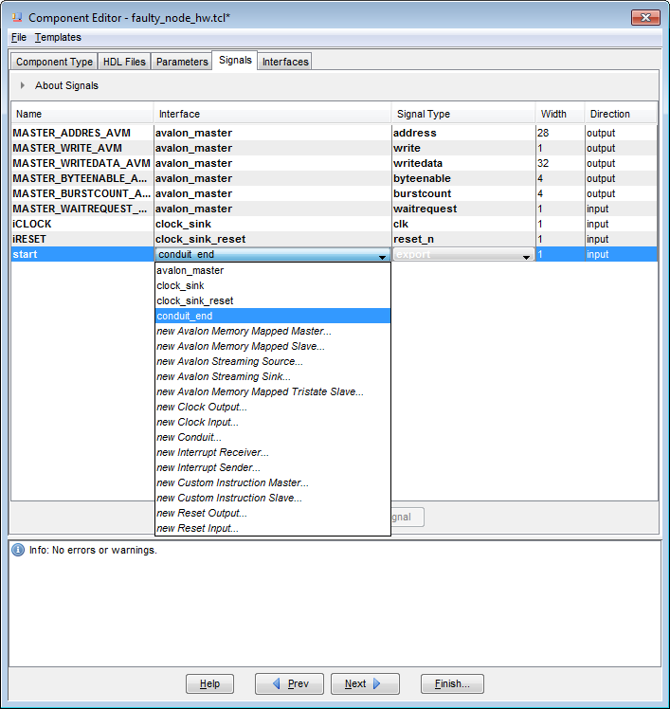
How to Integrate with SOPC/QSyS

Slide 13
Thank you.
Questions ?

