Slide 1
- Funcational Verification with Modelsim
Interfacing Customized Components
with Avalon Interconnect (II)
Gang Chen

Slide 2

FPGA Design Flow Overview
System Design
Funcational Verification
IO assignment and Analysis
RTL Synthesis
Static Timing Analysis
Gate-level Simulation
Place-and-Route
In-system Verification
(Sigal Tap Logic Analyzer,
In-system Memory Content Editor...)

Slide 3
Peroforming Functional Verification
Coducted before RTL Synthesis
To confirm that the design is functioning as intended
Performed on a design file available in the Behaviorial
Simulation view
Input
System Module
(Veilog HDL or VHDL)
Output
Test file
Output Wave Graph
Could be simple wave graph or complex system, such as SDRAM (to verify SDRAM controller).
Check Behavior

Slide 4
Modelsim Software
ModelSim is a powerful simulator that can be used to
simulate the behavior and performance of logic circuits.
You can get the software from the follwoing link:
http://www.altera.com/products/software/quartus-ii/modelsim/qts-modelsim-index.html
If you use Altera‘s IP (e.g., FIFO, RAM, etc.) in your system design project, you should add following files into your project.
220model.v and altera_mf.v (You can find them in the path of quartus_install_folder\eda\sim_lib)

Slide 5
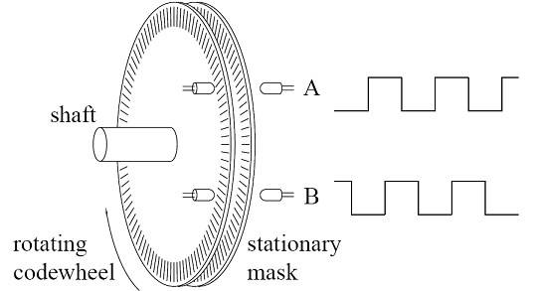
Evaluation Example----Measure the speed of the car based on optical encoder
Optical encoder is a device that converts motion into a sequence of digital pulse.

Slide 6
Optical encoder
When the mask in codewheel go through sensor A, one digital pulse is generated. By counting the pulse in one constant time, the rotation speed of motor can be obtained.
6

Slide 7
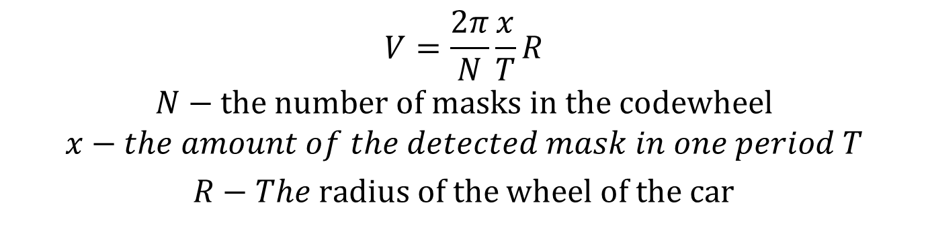
Optical encoder
$$V=\frac{2π}{N}\frac{x}{T}R$$
$$N−the number of masks in the codewheel$$
$$x−the amount of the detected mask in one period T$$
$R−The \text{radius}$ of the wheel of the car

Slide 8
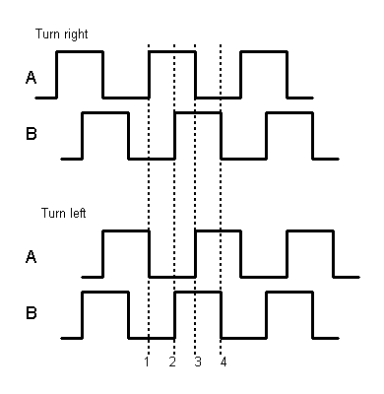
Indentifying the rotation direction of the Motor
Sensor A
Sensor B
Sender
Sender
Receiveer
Receiveer
Sensor A
Sensor B
Sender
Sender
Receiveer
Receiveer
90 degree phase gap

Slide 9
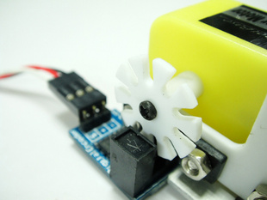
Make your own encoder----Maskwheel and Photoelectric switch is enough!
Your Motor
Photoelectric Switch
Maskwheel
9

Slide 10
Designing Your own IP to measure the speed and direction
A
B
clk
Timer
Clear Signal
Pulse Counter
Avalon Slave Interface
(To NIOS)
rst
Update the count
Function Block
Bus Block
Nios Core
Here we verify the function block in ths simple example!
The source code will be available in our wiki, you can add it directly into nios system.

Slide 11
Design your input---Testbench design
Assume the period of the pulse (wave A and wave B) wave is 1ms. At first, we generate 50 pulses with turn-right pattern, and followed by 80 pulses with turn-left pattern.
The IP mesaure the speed every 10ms (Default Setting).
Thus, the speed of pulses should be 10 (turn-right pattern) and -10(turn-left pattern) .

Slide 12
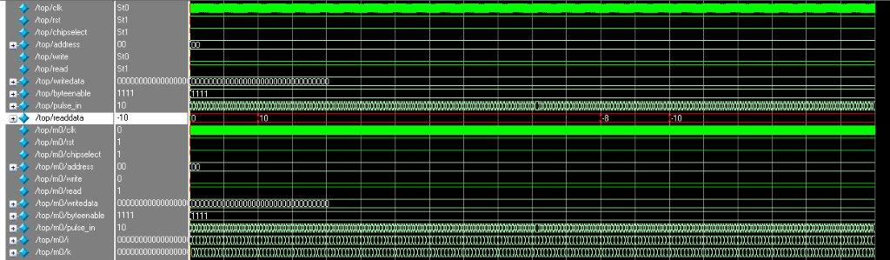
Run it in Modesim
In the beginning, IP can measure the speed as 10. During the sample period which
Contains both turn-right and turn-left pattern, the speed should be a value at [-10,10].
When it totally comes to turn-left pattern zone, the speed comes as -10.
About how to use modelsim, you can find a tutotial here:
http://www.stanford.edu/class/ee183/handouts_win2003/Modelsim_short_tutorial.pdf

Slide 13
Have Fun!
Thanks!

